Slide 1
Benefits of RxJS

Slide 2
Although RxJS is a great tool , at same time don’t get into an impression that it should automatically add it to every new project you start.
First understand the benefits and if they resonate with you and seem to solve some of the problems and concerns you have in your apps, then it's probably a good fit for you.
However, like any tool, it's right for some jobs and wrong for others.
Only you and your team can decide which is the case for your application.

Slide 3
A Better Asynchronous API

Slide 4
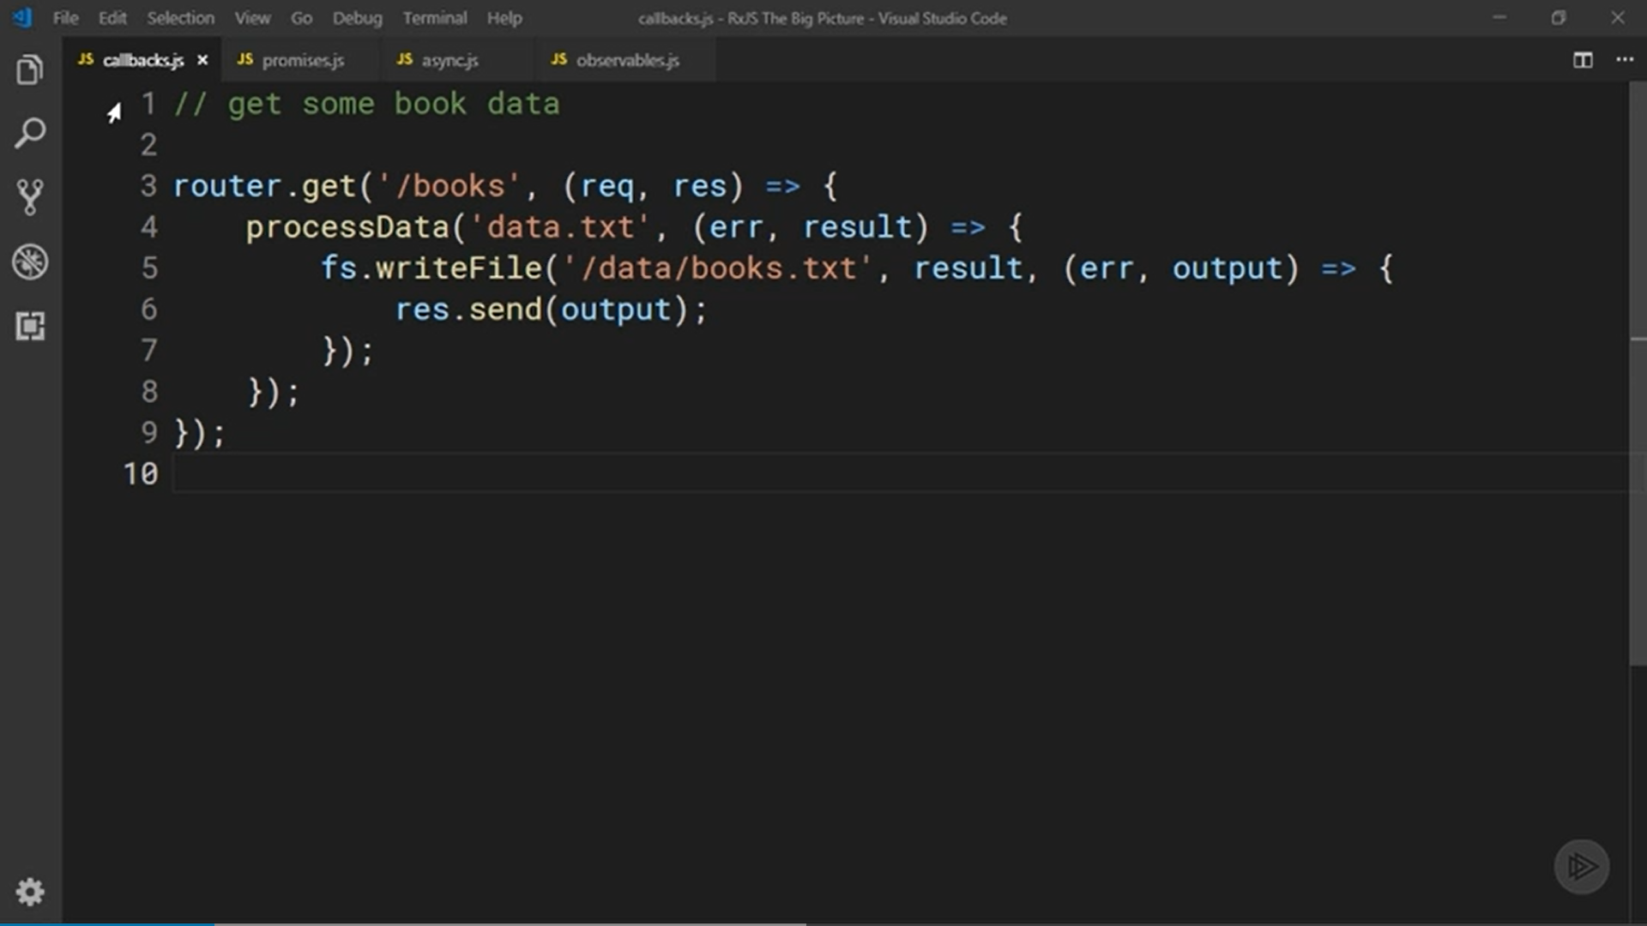

Slide 5
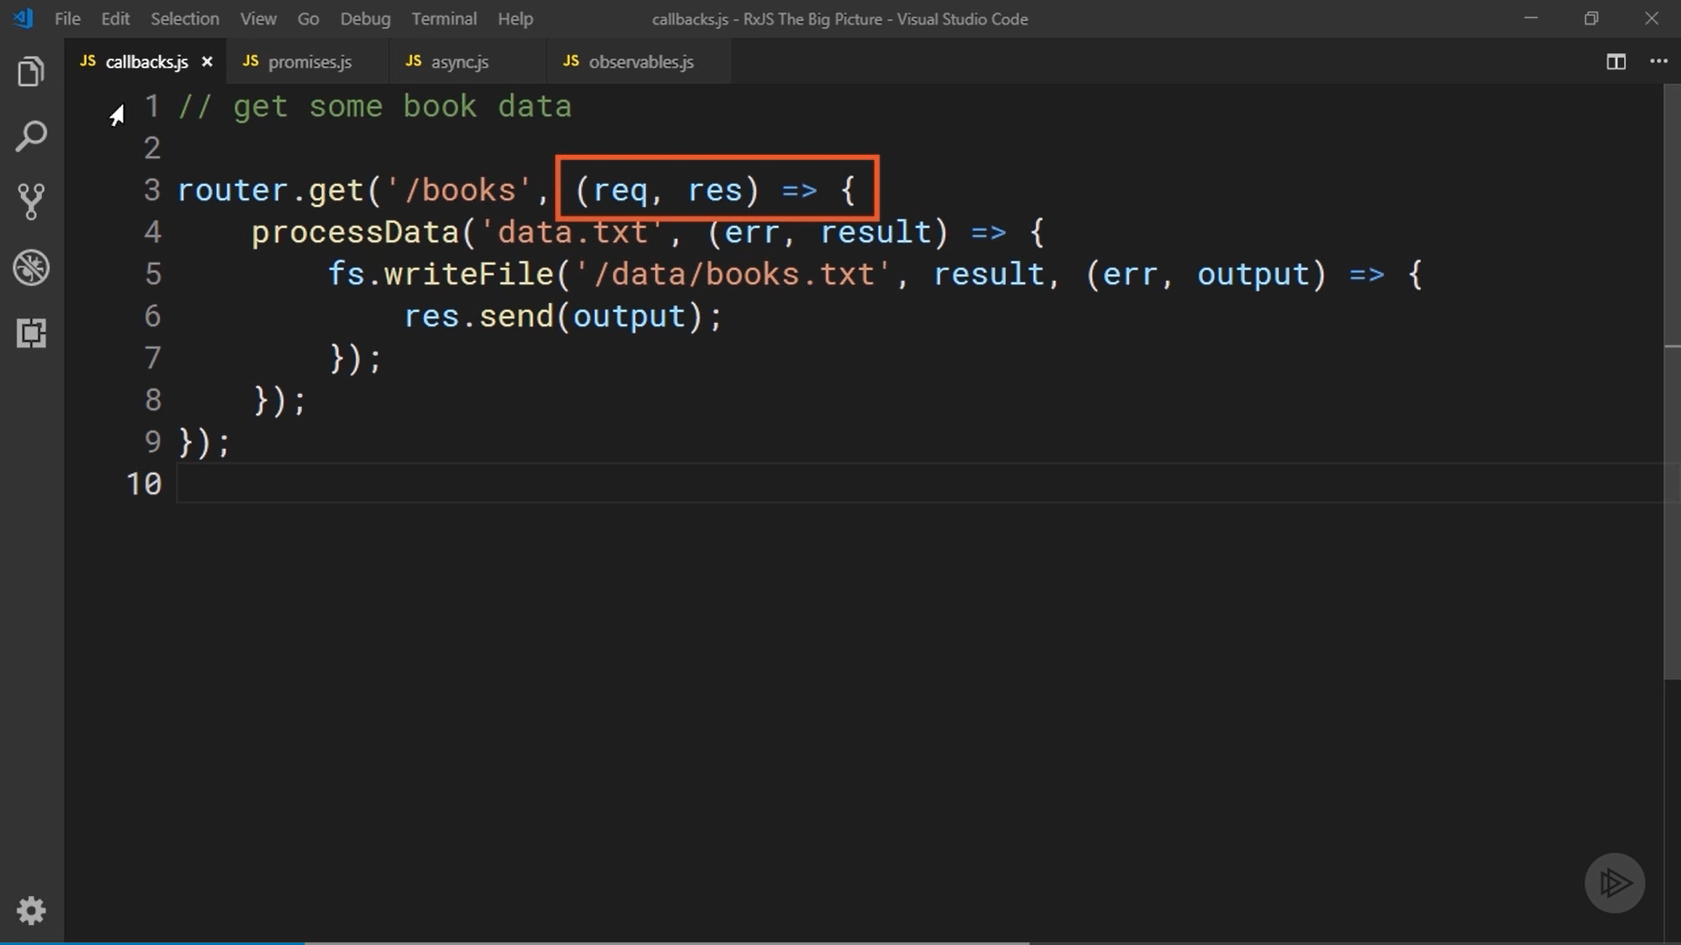

Slide 6
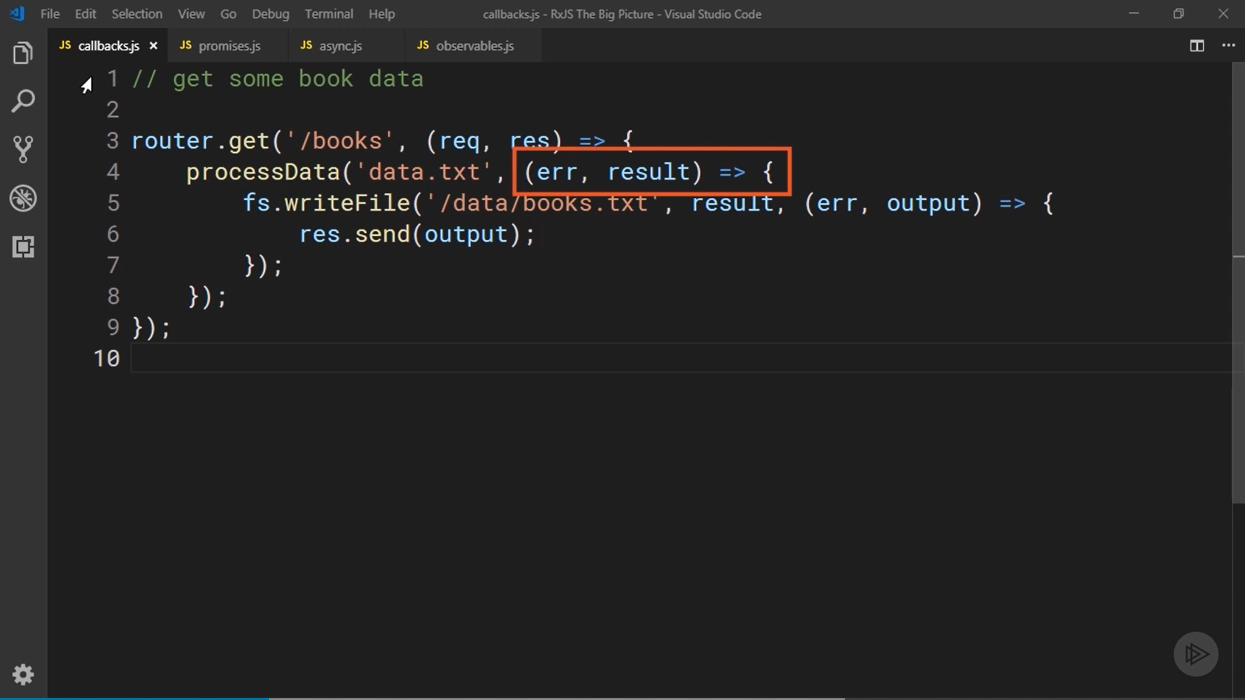

Slide 7
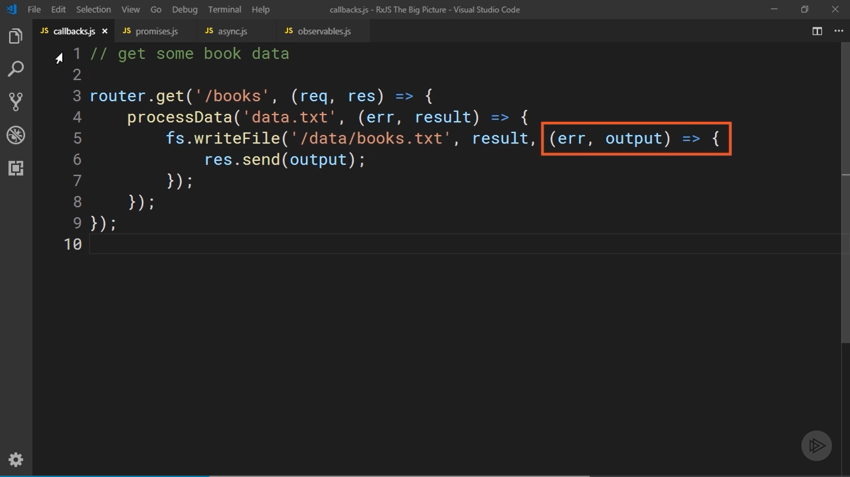

Slide 8
Basic example that uses a promise. First call a function that returns a promise. Then chain calls to the then, catch, and finally methods of the promise to handle any value or error it produces.
Though this is pretty easy to read, however, it's only good for asynchronously waiting on a single value.
Once the promise is resolved and the value is passed to the then function, that’s done.
You'll never receive more values. That's not ideal for situations when your data may arrive slowly over time.

Slide 9
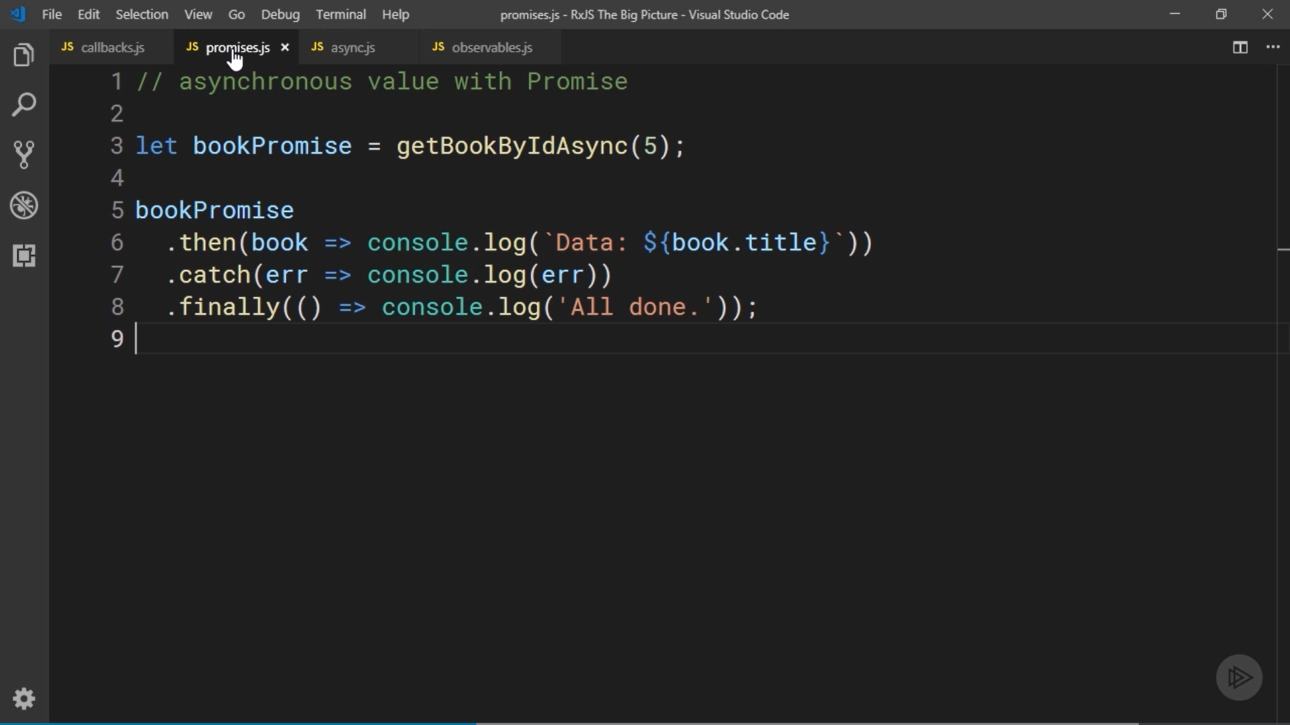

Slide 10
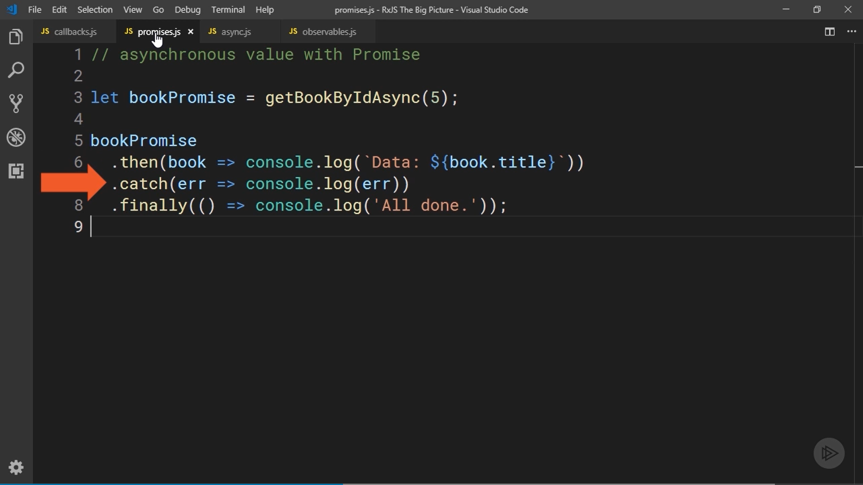

Slide 11
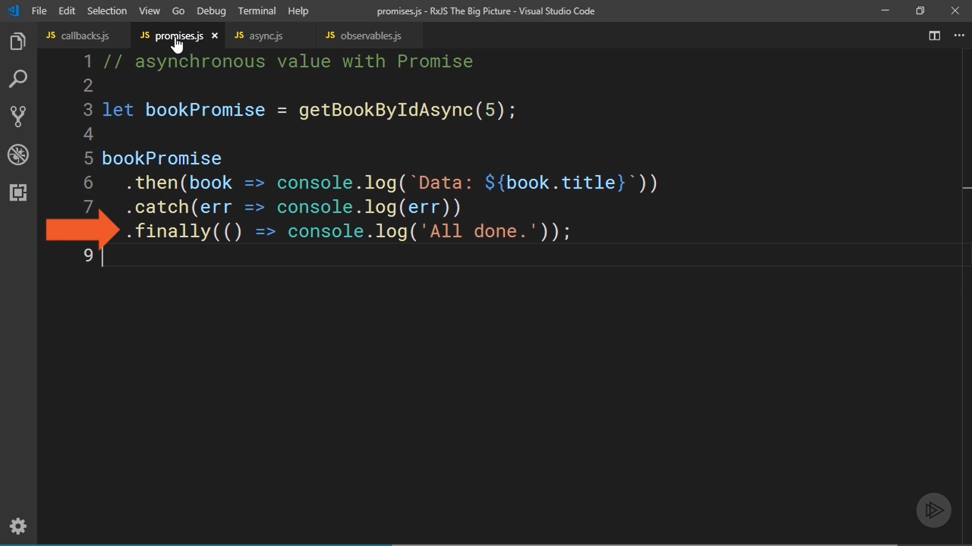

Slide 12
Using the async and await keywords is another option you have when writing asynchronous code.
it implicitly uses promises under the hood, so it's also only good for waiting on a single value.

Slide 13
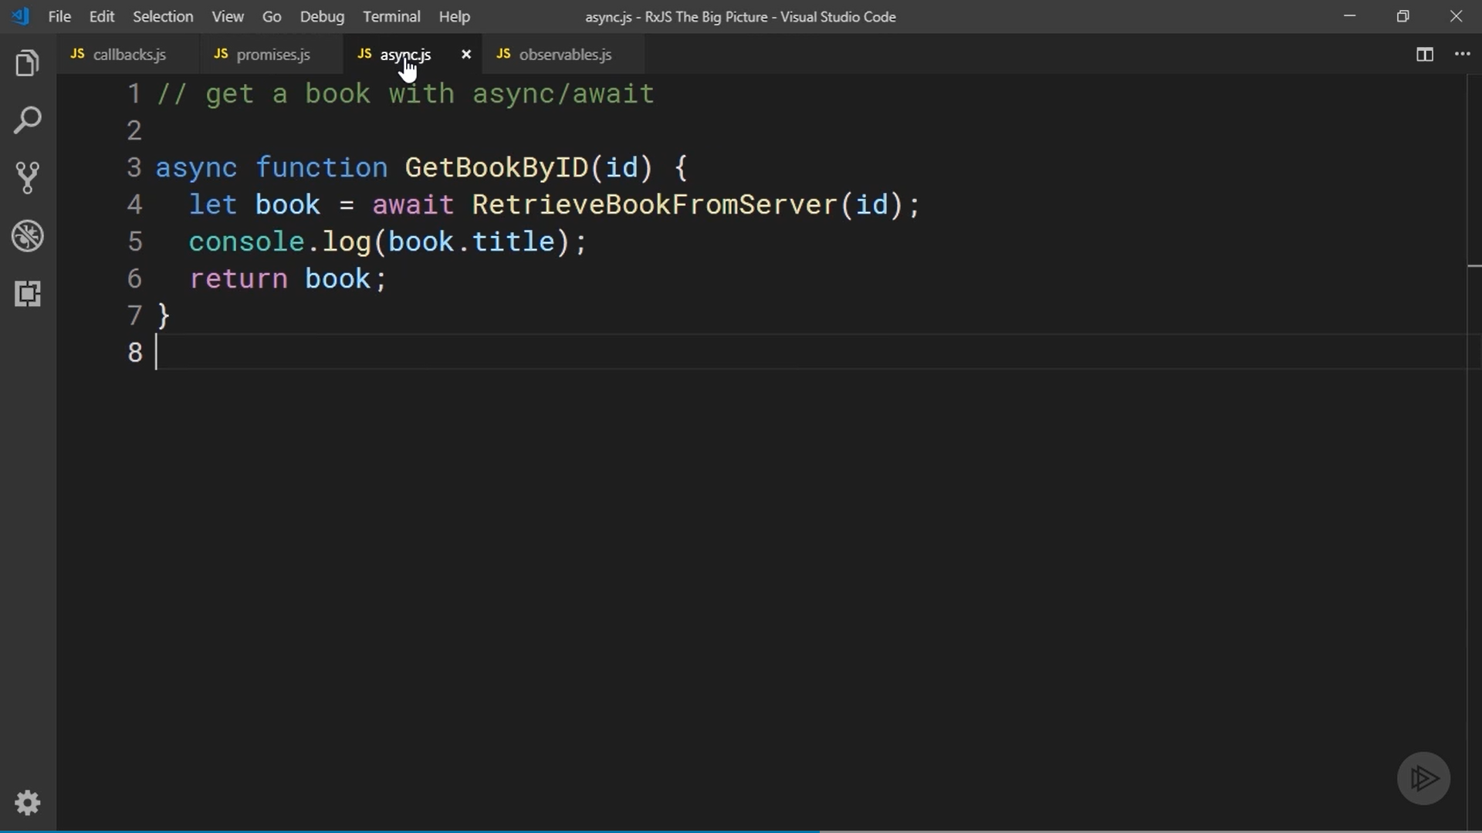

Slide 14
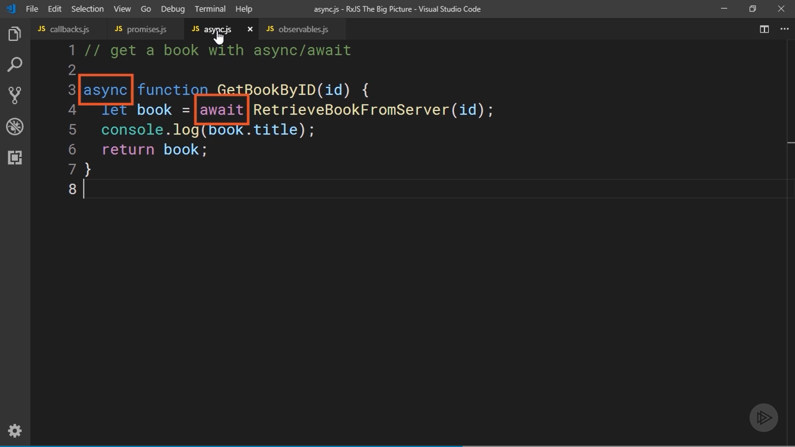

Slide 15
Very basic example that uses an observable in RxJS.
call a function that returns an observable and then call the subscribe function on that observable passing it the functions that should execute whenever the observable produces a value, an error, or reports that it's complete.
Syntactically, I think this looks similar to the promise code.
Both are pretty easy to read, but observable can produce multiple values over time.

Slide 16
As new processed books are produced by this observable, the first function passed to subscribe will be called with the new value. It will be called over and over until there is either an error or the observable completes.
This combination of readability plus being able to handle multiple pieces of data asynchronously make the observable API and RxJS far superior to the other techniques.

Slide 17
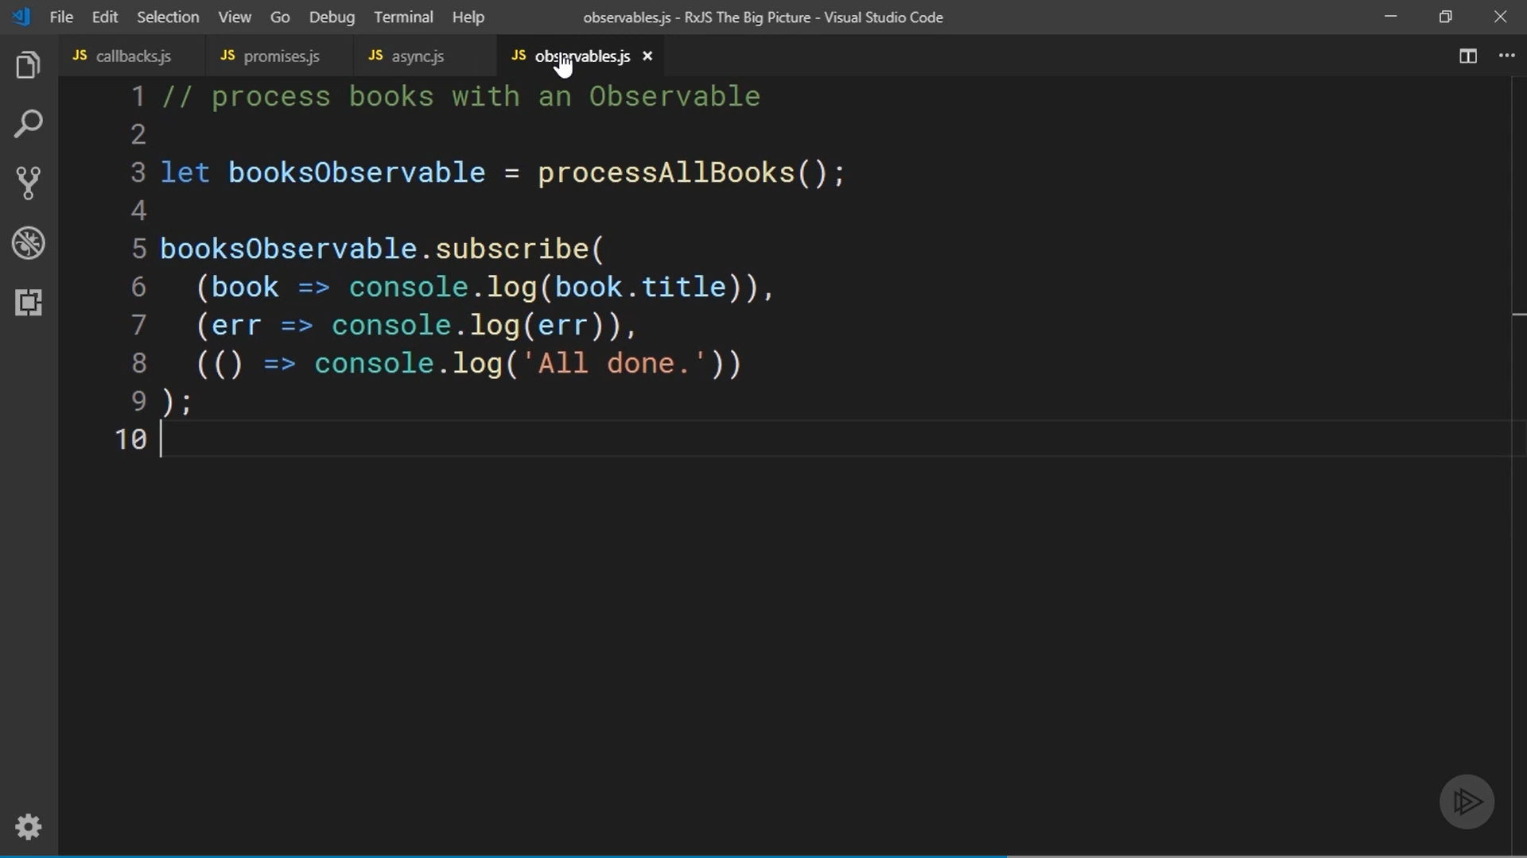

Slide 18
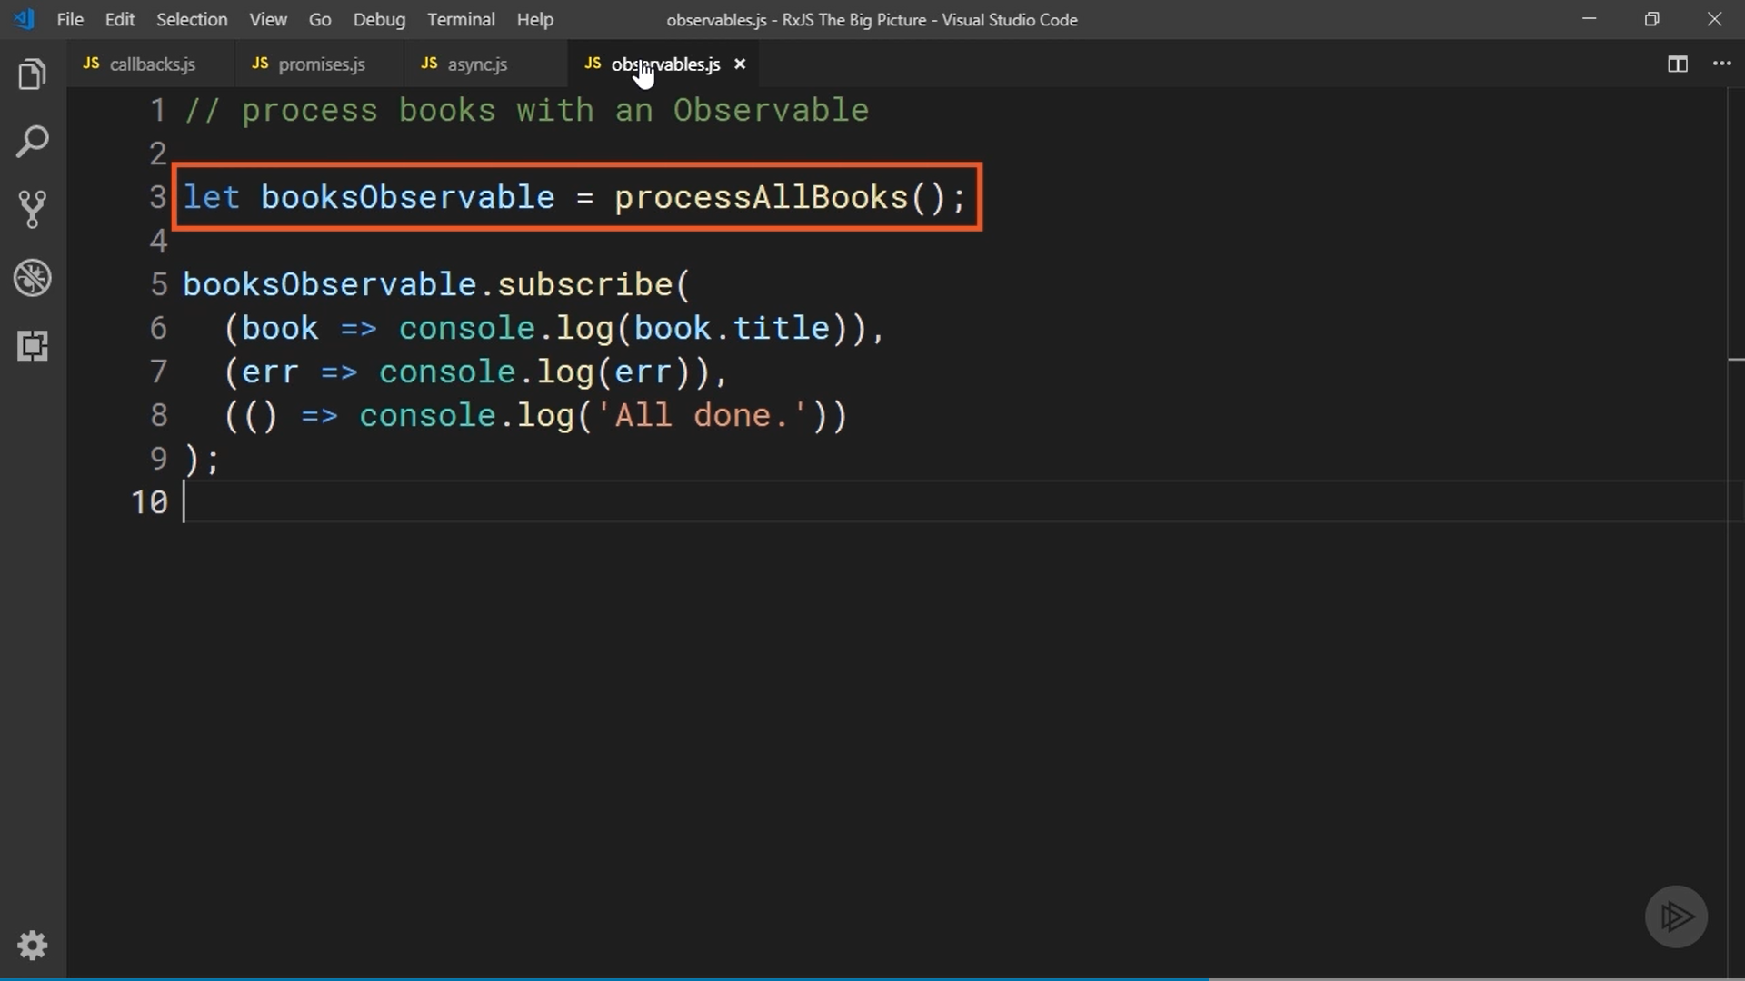

Slide 19
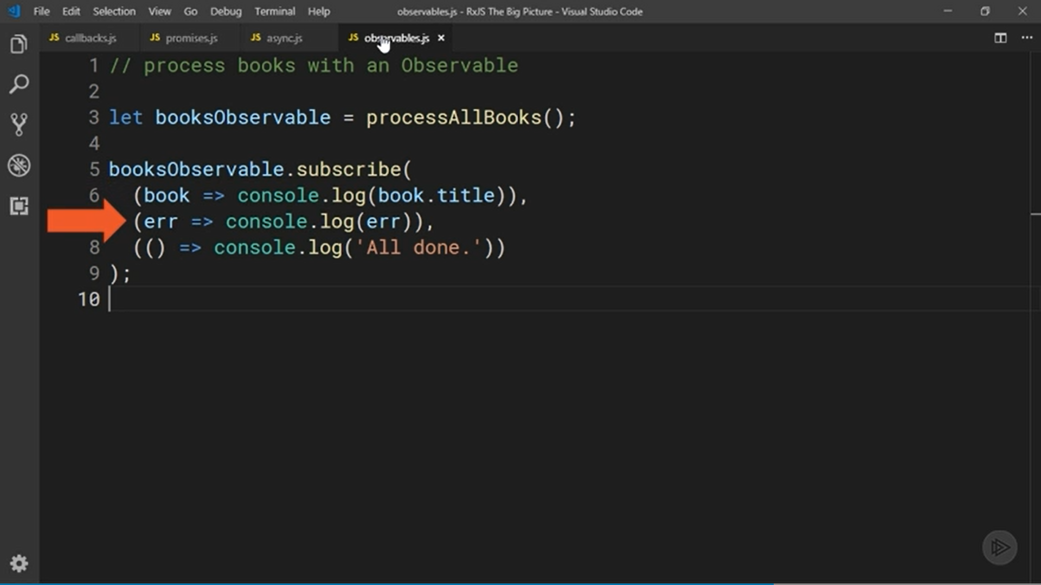

Slide 20
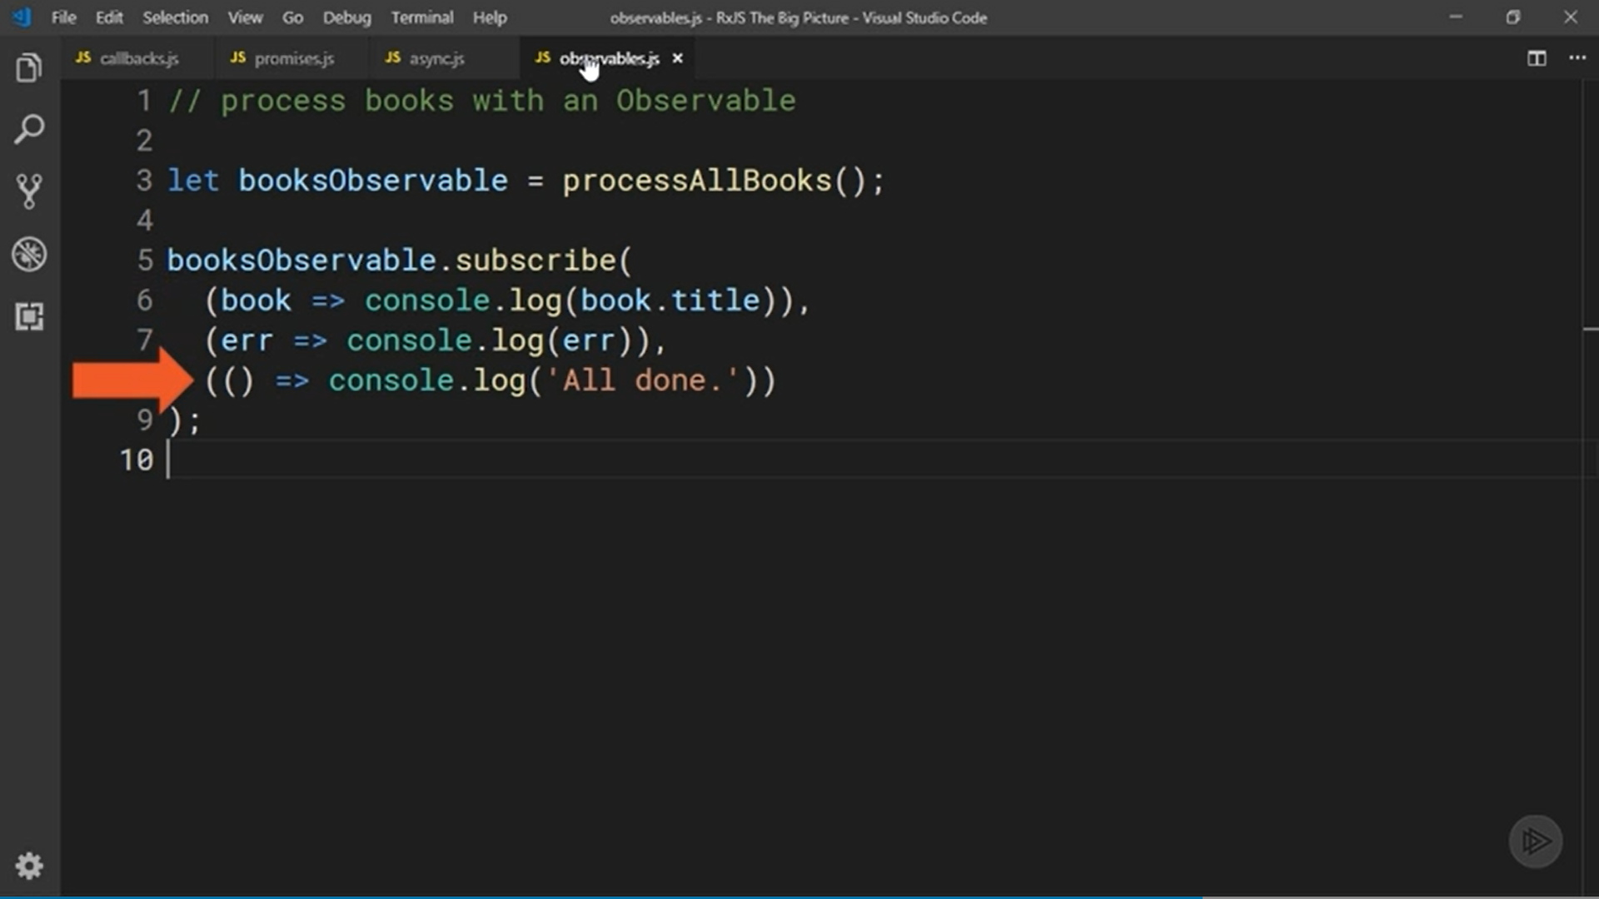

Slide 21
Programming Language Choice

Slide 22
You already know that the js in RxJS stands for JavaScript, but another benefit of using RxJS is programming language choice.
RxJS works great with all the features in the ES 2015 version of JavaScript, but it's worth pointing out that RxJS is actually written in TypeScript, which is a strongly-typed superset of JavaScript.
TypeScript's popularity continues to grow and RxJS includes type declaration files for all its types and functions.
This means you can trust the declaration files to stay in sync with the actual library and get excellent code completion support and parameter hints in an editor that supports those files.

Slide 23
JavaScript or TypeScript are your best options for working with RxJS, but as we have seen in the last module, the Reactive Extensions API has been implemented in lots of languages.
So once you're familiar with the API as it's implemented in RxJS, it's not a huge leap to then take advantage of reactive programming in other languages you use, perhaps in your server-side code.

Slide 24
Operators

Slide 25
So far, we have learned about how RxJS lets you react to data flowing into your application, but we haven't talked much about what you can do with that data once you have it.
This is where RxJS operators provide enormous benefits.
Operators are functions that manipulate the data produced by an observable and return a new observable.
Because they return a new observable, you can easily change several operators together to quickly refine and shape your data into exactly what you need in your app.

Slide 26
The official site for the RxJS documentation. The URL is rxjs.dev. Click on the reference link at the top and it takes to a page that shows all of the functions and types in the API.
Down this page is a section for all of the operators. The list is very long. There are currently over 100 operators included with the library that can perform just about any action you can imagine on your observable data.
They can help you transform it, filter it, combine it with data form other observables, and lots more.
In case you don't find an operator to do exactly what you need, you can create your own operator

Slide 27
Operators are the perfect complement to observables and together they provide you with a near complete solution for receiving and processing all types of data in your apps.
They're definitely one of the biggest benefits of using RxJS.

Slide 28
Maintenance and Enhancements

Slide 29
There are lots of factors you should consider before taking a dependency on an open source library.
One , It obviously needs to solve a technical problem, but you should also be confident that it's being actively maintained and enhanced.
RxJS has been around for several years now, look back over its version history, there is very steady stream of new releases, both major releases and those with smaller features and bug fixes.
The team working on it does a great job of releasing new features while also being mindful of the effect it will have on developers using the library.

Slide 30
The best example of this was the release of RxJS version 6 that came out in 2018.
It was a major release and included some big changes; however, the development team also released a companion compatibility package to make it as easy as possible for people using older versions to migrate to version 6.
If you've ever worried about a library you depend on disappearing overnight, it may also be comforting to know that the Angular team made the decision to include RxJS with Angular and use it heavily throughout the framework.
Even if you don't use angular, I think you can appreciate that a decision like that was a big deal and wouldn't have been made without complete confidence that RxJS would be around for a long time.

